Slide 1
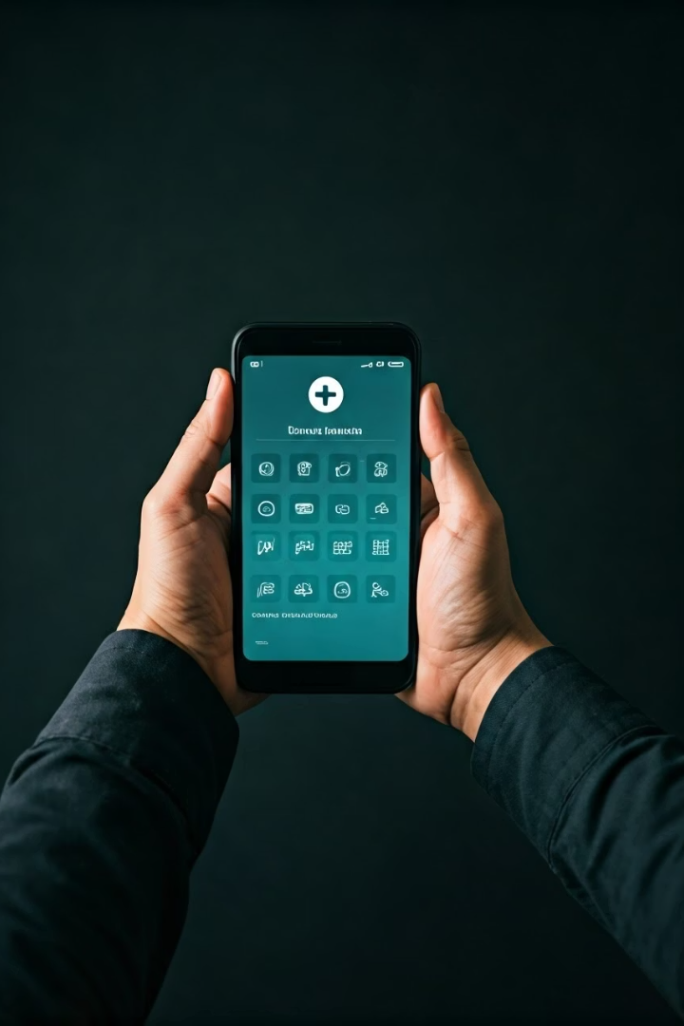
HealthConnect: Local Health Resource Finder
Empowering communities with quick access to nearby healthcare facilities.

Slide 2

Project Objectives
Easy Healthcare Access
Comprehensive Info
Intuitive Search
Help users find clinics, hospitals, and pharmacies nearby effortlessly.
Display services, hours, contacts, and navigation options.
Enable keyword and category-based searching with filters.

Slide 3
Challenges We Address
Problem Identification
User Needs
Limited centralized info on local healthcare
Quick, reliable access for emergencies and routine care
Difficulties locating open and appropriate facilities
Clear, organized info in simple UI
Lack of real-time availability indicators
Support for all ages and tech skill levels

Slide 4
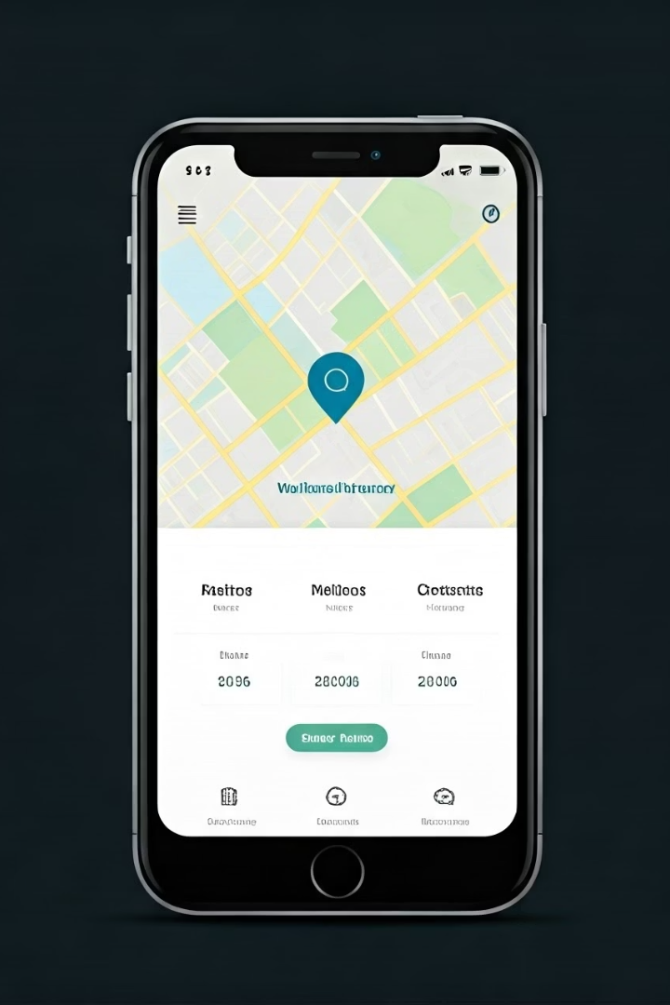
Innovative Solutions Offered
Smart Search & Filters
Keyword search, category selection, and filtering by proximity or hours.
Detailed Facility Info
Comprehensive data on services, contact, and operating hours.
Optional Chatbot
Basic AI assistant for quick health facility queries.
Mapping Integration
Use of Free Google Maps API for directions and location visualization.

Slide 5
Collaborative Team & Growth Potential
Team Strengths
Expansion Opportunities
Java & JavaFX expertise
Add real-time facility statuses and alerts
UI/UX focused developers
Broaden to rural and underserved areas
Integration with mapping APIs
Scalable for multiple languages and demographics
Potential mobile app adaptation

Slide 6




Presenter Challenges & Confidence Building
Overcoming Nervousness
Practice sessions and feedback loops build confidence.
Crafting Clear Messaging
Focus on benefits and real-world impact to inspire trust.
Engaging Delivery
Use storytelling and visuals to maintain audience attention.

